Slide 1
Motivation | 1 min | Background | 5 min | System Design & Implementation | 4min 30s | Eval & Conc | 5 mins
Why am I doing this |  | K-NNs | 40s | Dataset Collection | 30s | Testing | 2 mins
Problems with Hate Speech Detection |  | GRUs | 1 min | Text Analysis | 40s | Hate Network Showing | 1 min
 |  | Transformers | 1 min | Text Preprocessing | 1 min | Failed Attempts | 1 min
 |  | SVMs | 1 min | Configurations | 40s | Conclusion and Future Works | 1 min
 |  |  |  | Hate Network Algorithm | 1 min
 |  |  |  | Hate Network Detector Threshold Determination | 40s

Slide 2
Hate Speech and Hate Network Detection
By Jeetendra Joshi

Slide 3
Motivation
Social media is great but we all know there is a fundamental problem. Everyone loves how easy it is to setup and use but what happens when the wrong person/people/group manage to influence many by spreading hateful thoughts?
We saw in October last year that "Facebook has been unwilling to accept even little slivers of profit being sacrificed for safety"^{[1]}
I wanted to see whether I could do something about it
Sources: https://www.bbc.co.uk/news/technology-59038506

Slide 4
Problems with Hate Speech Detection
Hate Speech is large and varied
Cannot be done manually – We cannot monitor every social media post + we as humans have bias
Only detects one person at a time
Notes:
REMEMBERWEIGHT DECAY == 0. FIND A REASON WHY

Slide 5
Utilised Models
K-NNs
NBSVMs
BiGRUs
Transformers

Slide 6
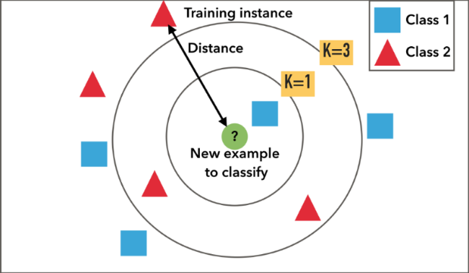
K-NNs
Supervised Learning Algorithm – Data is prelabelled
Each sample looks at its K closest neighbours and its class is determined by the majority class of its K neighbours

Slide 7
NBSVMs
Combines a support vector machine with naïve bayes log-count ratios.
Naïve Bayes log-count ratios – probability a word appears in positive class versus negative class

Slide 8
BiGRUs
Model that consists of two GRUs, one taking input in forward direction and other in a backwards direction
A GRU is similar to an RNN, but also contains an update and reset gate which determine the information passed to the output.
It looks at multiple input words to determine the output of the network.

Slide 9
Transformers
Encoder- Decoder Architecture

Slide 10
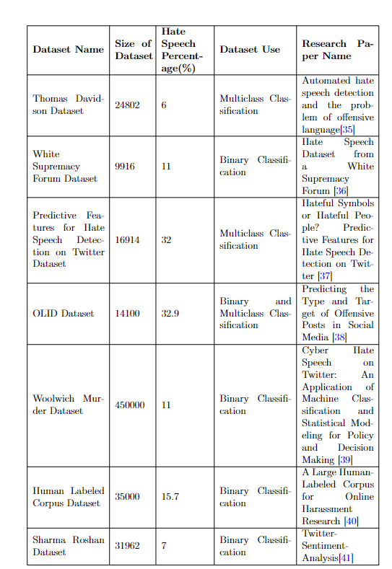
Dataset Collection
Looked at various publicly available datasets, mainly reading various papers and looking at sites such as hatespeechdata.com
Concluded on two datasets, Thomas Davidson dataset and Sharma Roshan Dataset

Slide 11
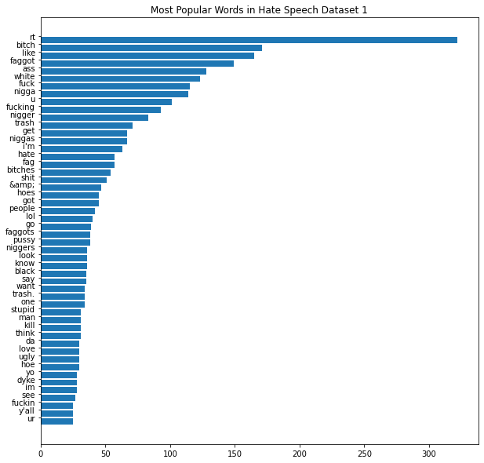
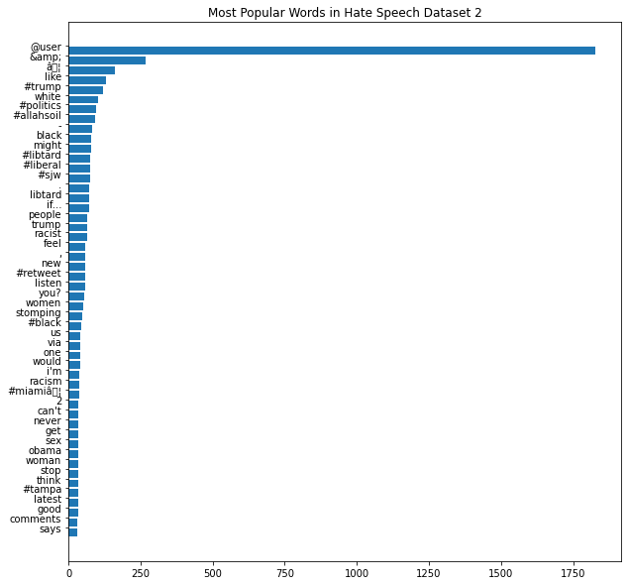
Text Analysis
Observed patterns in the data, more specifically each class
Found that certain terms were common in hate speech such as “@USER” tags and URLs.
Also, lots of profanity was found in hate speech terms (as expected)

Slide 12
Preprocessing
Before model development, the text was preprocessed to ensure that only useful data was input to the models.
This meant that the models would be learning the best possible information
Information Removed -> Punctuation other than exclamation points, question marks, commas and full stops
Information altered-> URLs and specific user tokens
Thomas Davidson set was altered from multi-class to binary classification

Slide 13
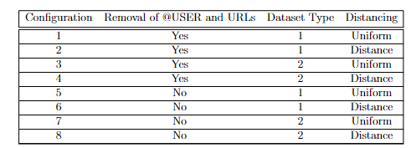
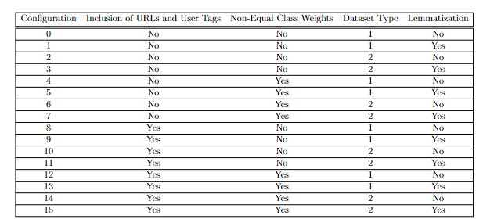
Configurations
KNN’s
NBSVM’s, BiGRU’s and Transformers

Slide 14
Model Training

Slide 15
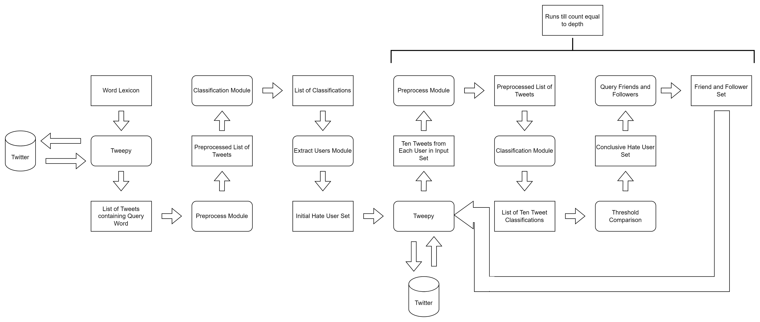
Hate Network Algorithm

Slide 16
Testing – Hate Speech Detection

Slide 17
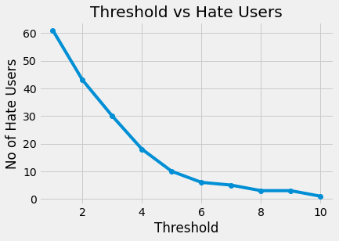
Testing – Thresholding for Hate Network Detection
As mentioned previously: we have a threshold we need to determine
We query every word in our lexicon and classify the tweets from every user to get an initial hate set -> 63 people
We look at each of those users’ past ten tweets and classify each of them applying a threshold from 1 to 10
We get a band at the bottom where there isn’t much change like an elbow plot. The value of 7 was chosen for this investigation

Slide 18
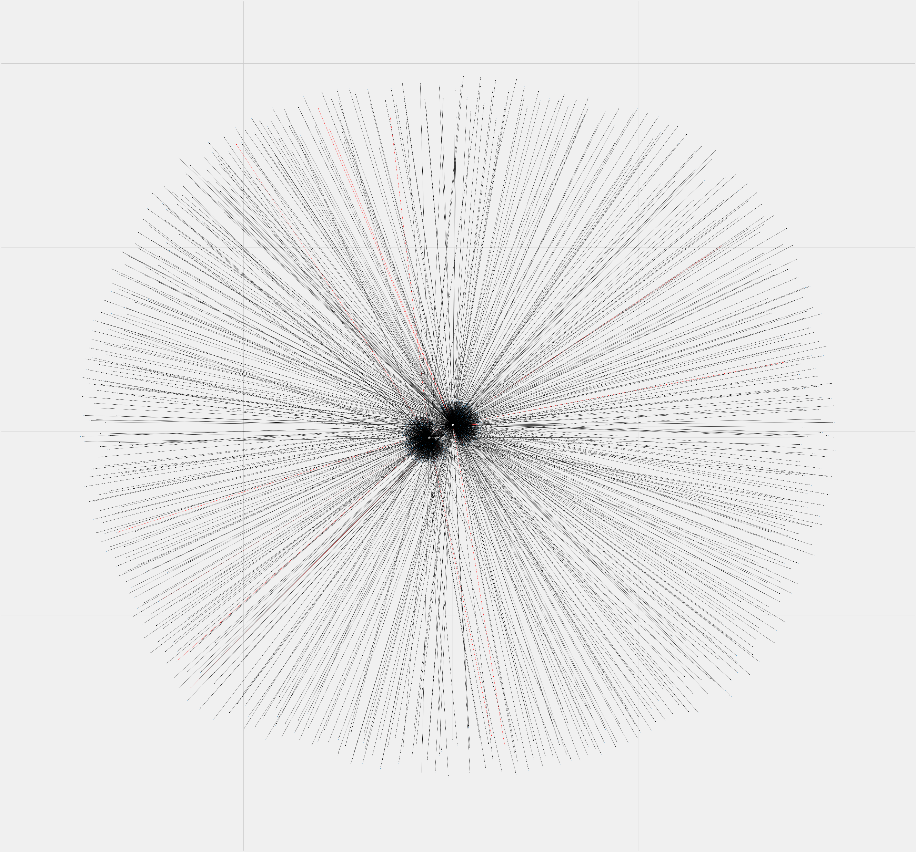
Testing – Hate Network Detection
With this, you get really cool images like on the right ->
This is a hate network detected by the algorithm. At the end of each line is a user. Red lines are connections between hate users.
Problem -> This only looks as 2 initial hate users, doesn’t go further than their friends and took 3.5 hours to generate

Slide 19
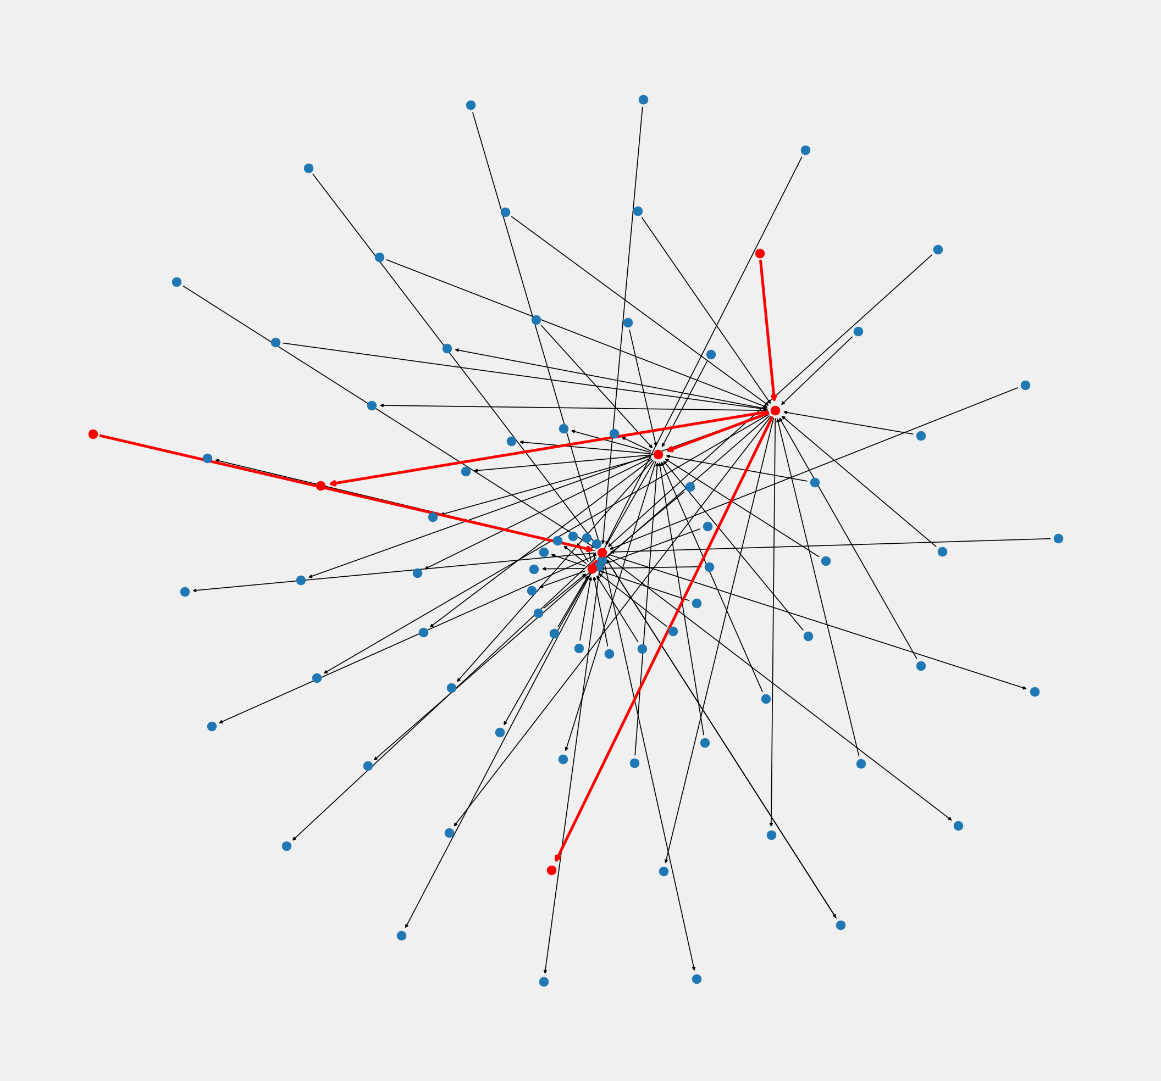
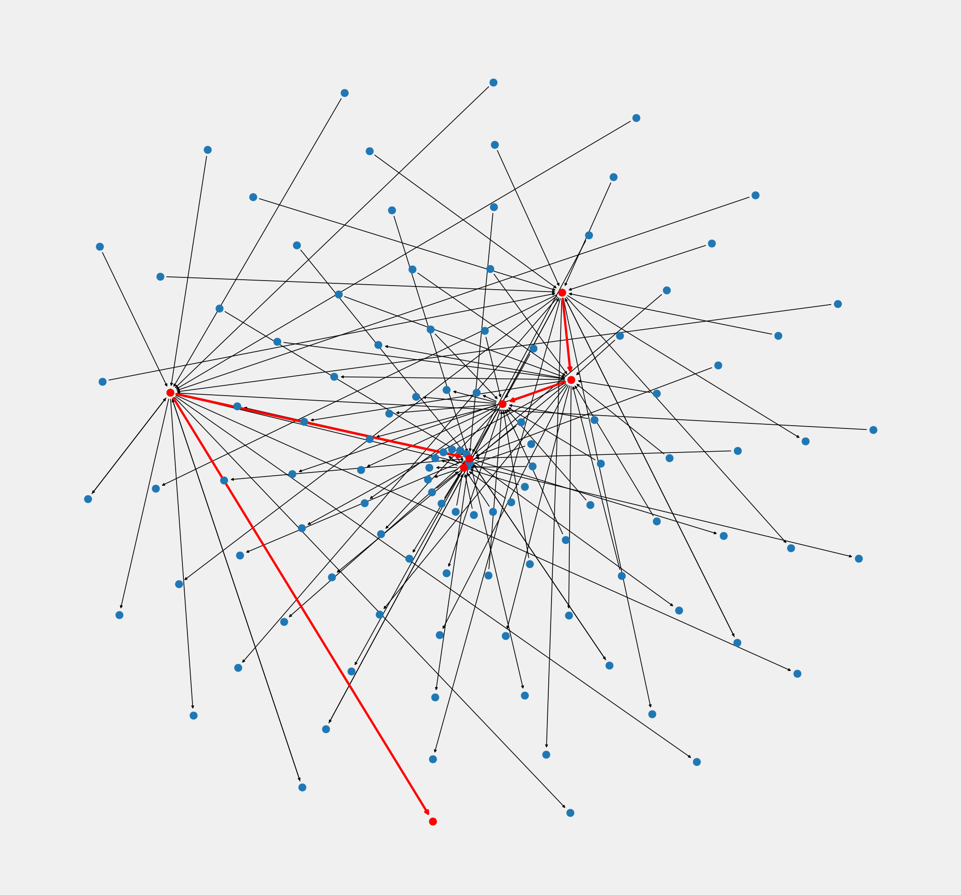
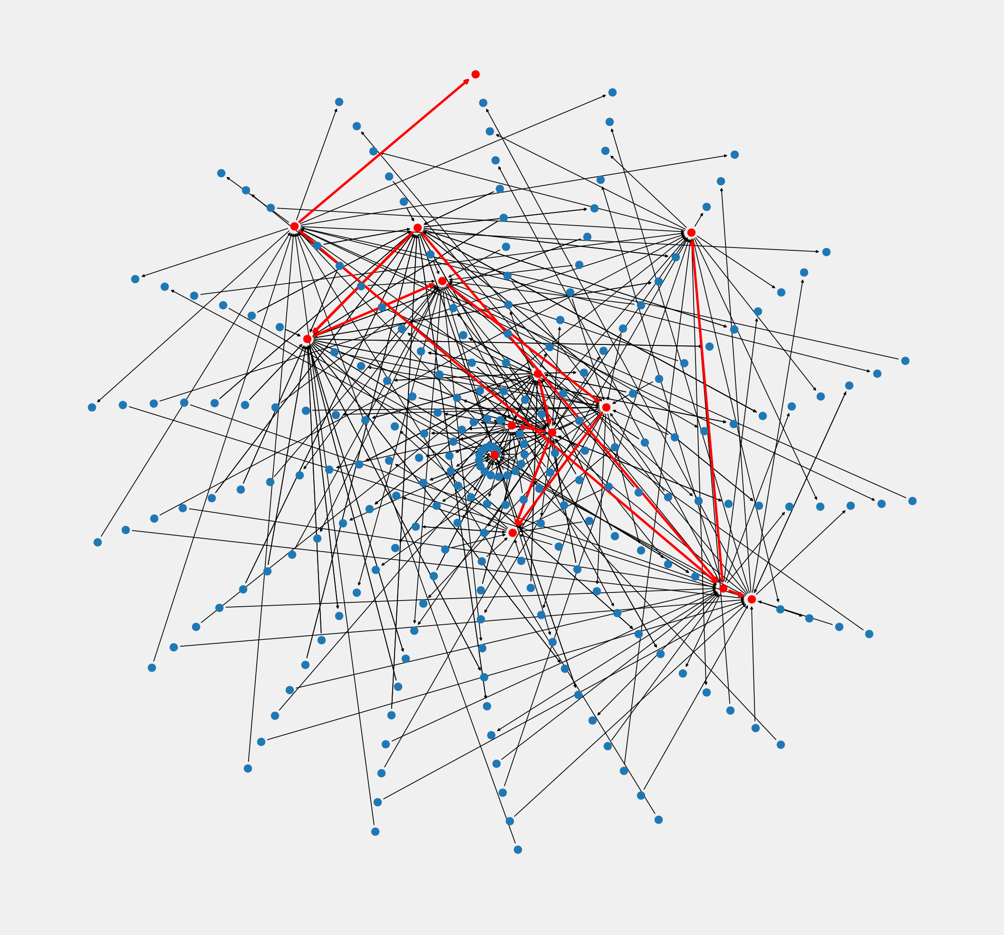
Testing – Hate Network Detection
Less friends and followers but we can go deeper (and it doesn’t take 3 hours):
Depth 3
Depth 4
Depth 10

Slide 20
Failed Attempts

Slide 21
Conclusion and Future Works
Let’s hope Twitter will actually do something with this!

Slide 22
Questions?

